Slide 1
Gradient Descent

Slide 2
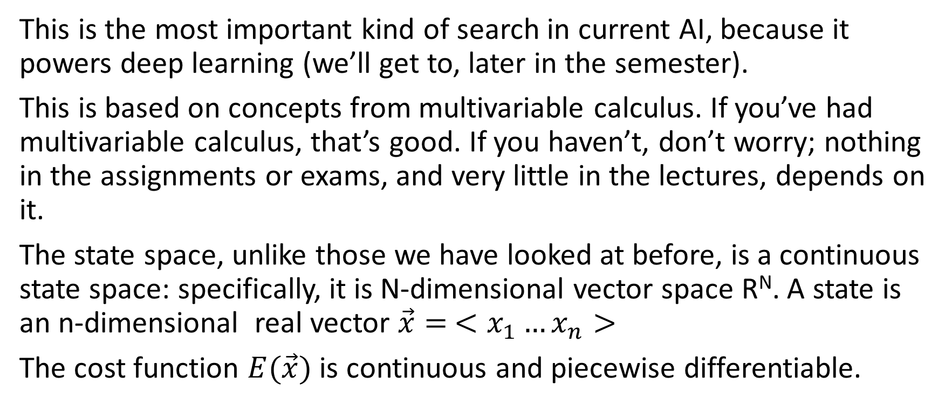
Gradient Descent
This is the most important kind of search in current AI, because it powers deep learning (we’ll get to, later in the semester).
This is based on concepts from multivariable calculus. If you’ve had multivariable calculus, that’s good. If you haven’t, don’t worry; nothing in the assignments or exams, and very little in the lectures, depends on it.
The state space, unlike those we have looked at before, is a continuous state space: specifically, it is N-dimensional vector space R^{N}. A state is an n-dimensional real vector $\vec{x}= <x_{1}…x_{n}>$
The cost function $E(\vec{x})$ is continuous and piecewise differentiable.

Slide 3
Intuition
You are trying to find your way to the top of a mountain. But it is completely foggy; you can’t see an inch in front of you. What you can do is feel with your feet which direction the ground at your feet is sloping. So you feel which direction is uphill, and you take a small step in that direction. Then you iterate until the ground at your feet is flat. Maybe you’re at the top then. In any case, there’s nothing more you can do.
(Doesn’t really work with a mountain, because the surface is so uneven, but functions − even AI functions --- are a lot smoother.)

Slide 4
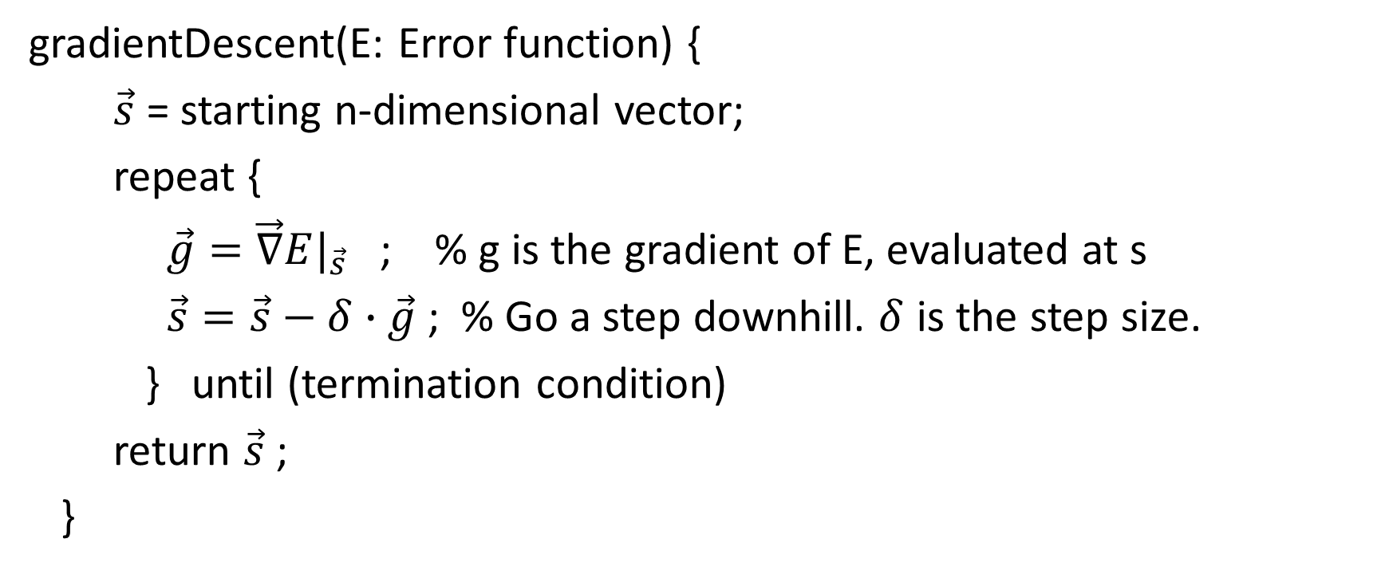
Gradient descent algorithm
gradientDescent(E: Error function) {
$\vec{s}$ = starting n-dimensional vector;
repeat {
$\vec{g}=\vec{∇}E|_{\vec{s}}$ ; % g is the gradient of E, evaluated at s
$\vec{s}=\vec{s}−δ∙\vec{g}$ ; % Go a step downhill. $δ$ is the step size.
} until (termination condition)
return $\vec{s}$ ;
}

Slide 5
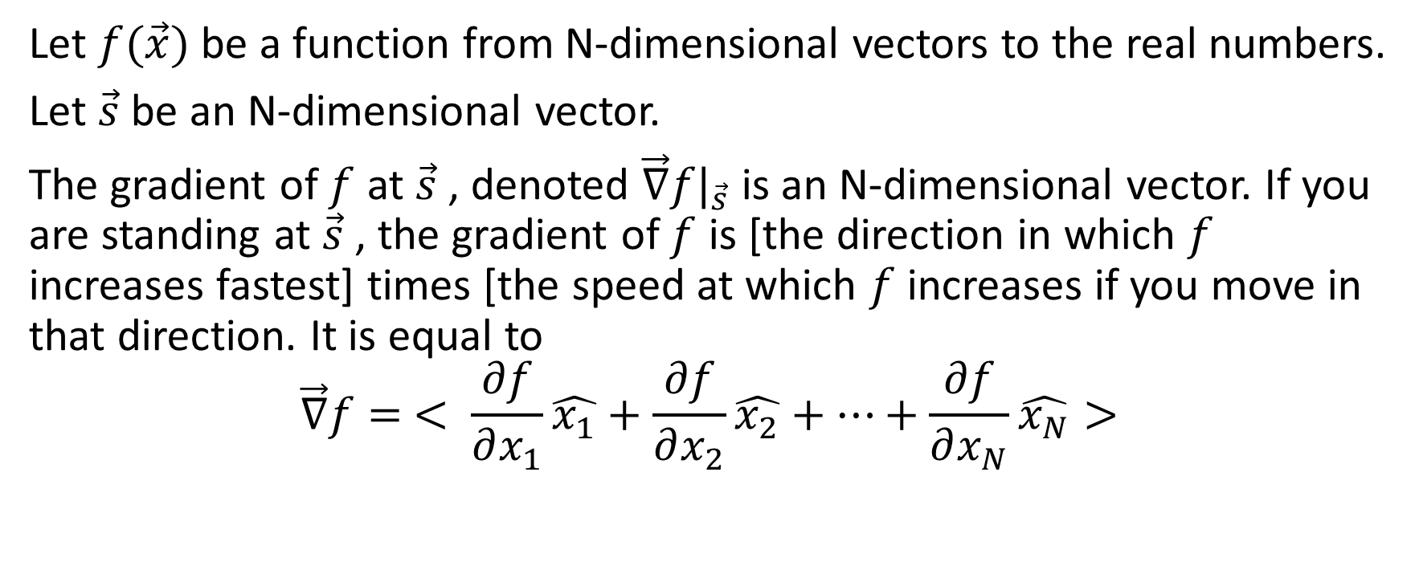
The gradient
Let $f(\vec{x})$ be a function from N-dimensional vectors to the real numbers.
Let $\vec{s}$be an N-dimensional vector.
The gradient of $f$ at $\vec{s}$ , denoted $\vec{∇}f|_{\vec{s}}$ is an N-dimensional vector. If you are standing at $\vec{s}$ , the gradient of $f$ is [the direction in which $f$ increases fastest] times [the speed at which $f$ increases if you move in that direction. It is equal to
$$\vec{∇}f= < \frac{∂f}{∂x_{1}}\hat{x_{1}}+\frac{∂f}{∂x_{2}}\hat{x_{2}}+…+\frac{∂f}{∂x_{N}}\hat{x_{N}}>$$

Slide 6
Gradient descent
You need to define the error function so that you can easily compute the gradient. (In fact, in gradient descent, it is much more important to compute the gradient than the actual value of the error function.)
When we get to the section on learning, we’ll discuss how that’s done.
Visualization

